Slide 1
Statistical methods in epidemiology. Meta-Analysis
FA.Iskakova

Slide 2
Objectives:
Measures of disease occurrence;
Measures of association between risk factors (exposures) and health outcomes on absolute and relative scales
Estimation of attributable fractions of disease occurrence related to a particular exposure in analytical studies;
Describe the purpose and appropriateness of statistical tests commonly reported in published health literature
Demonstrate proficiency in making refined interpretations of statistical results

Slide 3
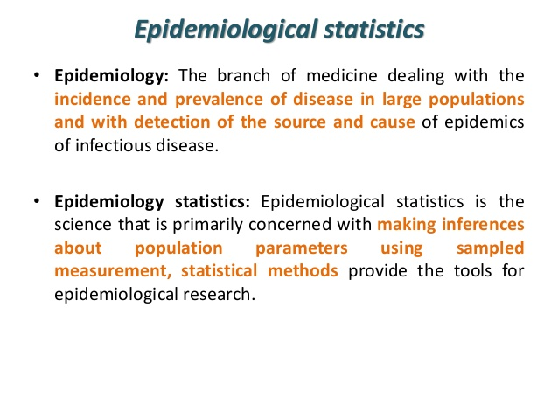

Slide 4
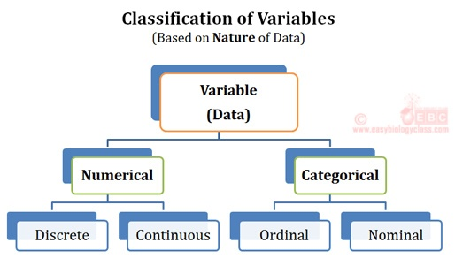
Blood Group: A, B, AB or O
Age in years
Number of visits to clinic
Can take specific value
in a range
Class (1,2,3etc.
Pain(none/mild/severe)
Pain Rating scale
Ethnic group (Caucasian/Asian/AfroCaribbean)

Slide 5
Quantitative Data
Quantitative Data | Examples
Numbers -actual number of events | 1000 cases of TB in community A
Rate -a proportion with time element that measures the occurrence of an event overtime | Incidence rate of TB in Kazakhstan is 45 cases per 100 000 population
Ratio- the magnitude of one occurrence X, in relation to another event Y as X/Y | Ratio of TB cases in males to females is 2:1
Proportion- a ratio in which the numerator is included in the denominator | Proportion of TB cases in community A is 10%

Slide 6
Qualitative Data
Qualitative Data are defined as the data that approximates and characterizes.
This data type is non-numerical in nature
This type of data is collected through methods of observations, one-to-one interview, conducting focus groups and similar methods.
Qualitative data in statistics is also known as categorical data.
Data that can be arranged categorically based on the attributes and properties of a thing or a phenomenon.
Qualitative Data Examples:
Questionary, case report, visit etc.

Slide 7
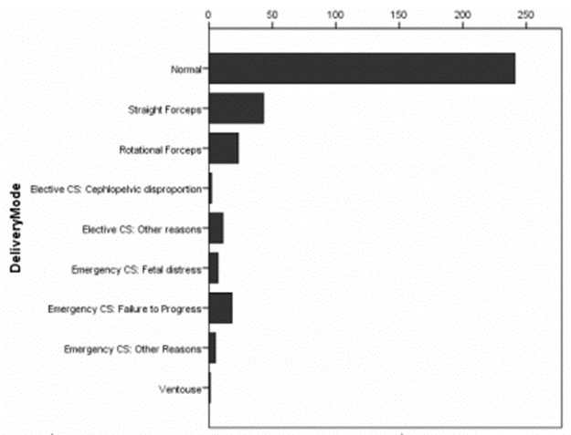
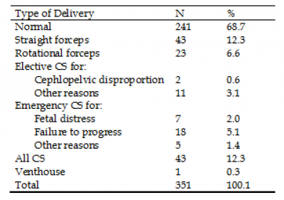
GRAPHYCAL DISPLAYS: 5 types of display
Bar-chart
Table

Slide 8
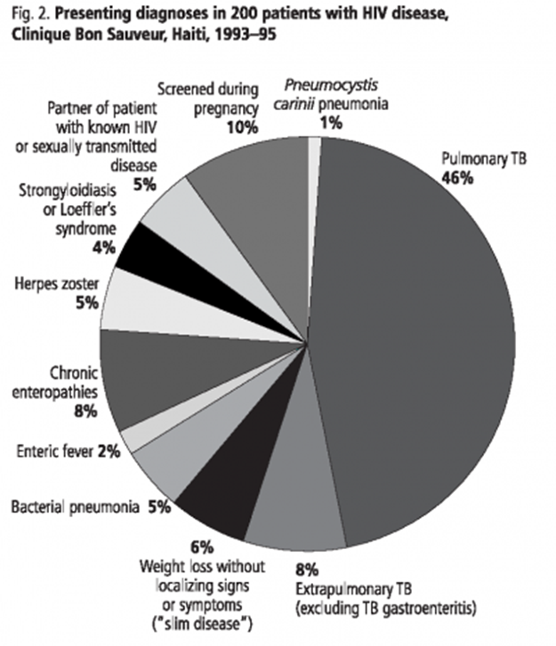
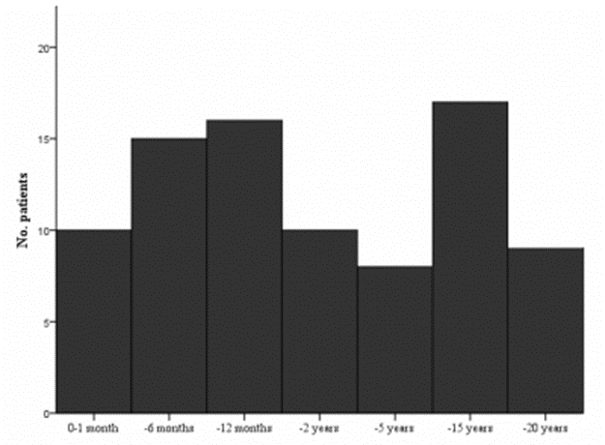
Pie-chart Histogram

Slide 9
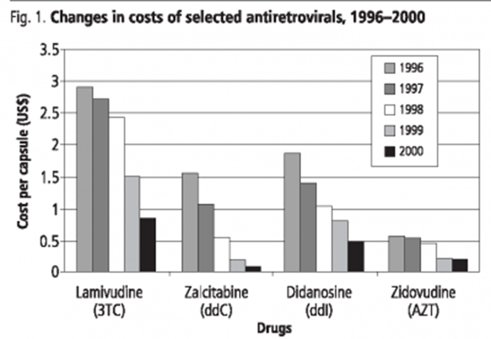
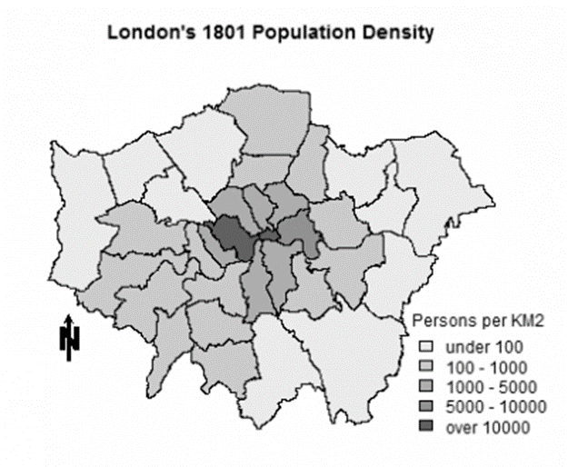
Diagram Map

Slide 10
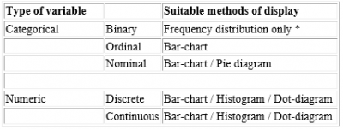
The type of variable may influence the appropriate means of display:

Slide 11
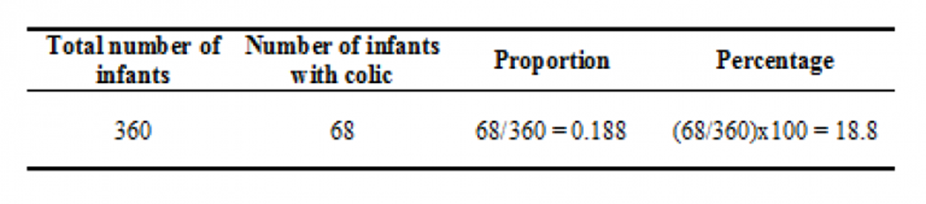
SUMMARIZING CATEGORICAL DATA
the proportions (or percentages)
rate
From this sample the proportion of infants with colic is 0.188 and the equivalent percentage is 18.8%
The rate of colic is 0.188 or 18.8 per 100, or 188 per 1000.

Slide 12
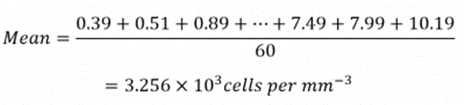
Summarizing Numerical Data
Summarizing numeric data depend on the distribution of the data
The Mean is the most widely known measure of average
For example, there are 60 children who were drug withdrawn at birth, to calculate their mean we need to add together the 60 CD4 measurements from these children:
MEDIAN is the middle value when a data set is ordered from least to greatest.
The MODE is the number that occurs most often in a data set.

Slide 13
Measure of disease occurrence
Ratios | Quantifies the magnitude of one occurrence X, in relation to another event Y as X/Y | e.g Ratio of TB cases in community A to B is 1:10
Proportions | Ratio of TB cases in community A to B is 1:10 | e.g proportion of TB cases in community A is 10%
Rates: | a proportion with time element It measure the occurrence of an event overtime | e.g # measles cases in 2000/ # population in 2000

Slide 14
TYPES OF RATES
Crude rates: Apply to the total population in a given area
Specific rates: Apply to specific subgroups in the population (age, sex etc) or specific diseases
3. Standardized rates: used to permit comparisons of rates in population which differ in structure (e.g age structure)

Slide 15
TYPES OF RATES
MORBIDITY RATES:
Incidence rates(Cumulative incidence, incidence density)
Prevalence (Period prevalence, point prevalence)
MORTALITY RATES:
Crude death rate
Age-specific mortality rate
Sex-specific mortality rate
Cause-specific mortality rate
Proportionate mortality ratio
Case fatality rate
Fetal death rate

Slide 16
Measures of association

Slide 17
Measures of Risk and Rate
Risk is defined as the number of new cases divided by the total population-at-risk at the beginning of the follow-up period.
An individual's risk of developing the outcome of interest is measured
A Rate is the number of new cases of a health outcome divided by the total person-time-at-risk for the population.
Rate measures the rapidity of health outcome occurrence in the population.

Slide 18
Risk Ratio
When risks are computed in a study,
The Risk Ratio is defined as the risk in the exposed cohort (the index group) divided by the risk in the unexposed cohort (the reference group).
the Risk Ratio is the measure that compares as
Example, suppose researchers conduct a cohort study and gather the following data on the effects of gasoline fume exposure on respiratory illness among automotive workers.
 | Disease | No Disease | Total
Exposed | 60 | 140 | 200
Un-exposed | 25 | 175 | 200
Total | 85 | 315 | 400
A risk ratio

Slide 19
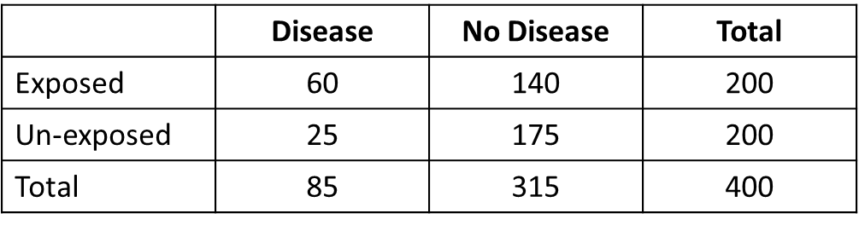
Rate ratio
When rates are computed in a study,
The rate ratio is defined as the rate of health outcome occurrence in the exposed cohort (the index group) divided by the rate of health outcome occurrence in the unexposed or less-exposed cohort (the reference group).
If in the previous example, the person-time-at- risk that each automotive worker contributed to the study had been recorded then the table might have looked like the following:
the rate in the exposed cohort ?
The rate in the unexposed cohort?
The rate ratio ?

Slide 20
Risk ratio or Rate ratio
The following table may be applied to both risk and rate ratios
Risk ratio or Rate ratio | Exposure
<1 | Exposure is protective
=1 | Exposure is neither preventive nor
>1 | Exposure is harmful
The farther away the risk ratio or rate ratio is from the null value of one, the greater the effect of exposure is on the study group. This is shown in the following diagram.
RR
Risk is lower in the exposed
Risk is greater in exposed
1.0

Slide 21
Attributable Rate (AR)
In order to find the absolute effect of an exposure a health outcome the attributable rate (AR) must be computed.
The attributable rate is the excess rate among the exposed population attributed to exposure.
It is defined as the rate in the exposed minus the rate in the unexposed.
AR% (exposed)=
risk in exposed – risk in unexposed
x 100 risk in exposed
PAR%(total population)=
risk in total pop– risk in unexposed
x 100 risk in total population
Rate Difference =
Rate exposed – Rate unexposed

Slide 22
Measures of association
Chi-square statistics
OR – ODDS Ratio
RR – Relative Ratio

Slide 23
Chi-square statistics
Chi-square tests whether there is an association between two categorical variables
Ho: There is no association between row & column variables
Ha: There is an association between row and column variables
Chi-square statistic has a degree of freedom (r-1)(c-1), where r is number of rows & c number of columns
X² = Σ (O - E)² E | O: Observed cells E: Expected cells | Expected value = (Row total)X(Column total) Grand total | Χ ² = (/ad-bc/-n/2)²n (a+b)(a+c)(c+d)(b+d)

Slide 24
Odds ratio (OR)
Odds ratio is the ratio of odds of exposure among diseased to odds of exposure among non-diseased
Odds of an event E is the ratio of probability of the event to its complement
Odds of exposure among exposed=a/c
Odds of exposure among non-diseased=b/d
OR = Odds of exposure among diseased
Odds of exposure among non-diseased
OR= (a/c)/(b/d); OR= ad/bc

Slide 25
Relative risk (RR)
Expresses risk of developing a diseases in exposed group (a + b) as compared to non-exposed group (c + d)
RR = Incidence (risk) among exposed
Incidence (risk) among non-exposed
RR= a/(a+b)
c/(c+d)
What does a RR of 2 mean? Thus a relative risk of 2 means the exposed group is two times at a higher risk when compared to non-exposed
Strength of association: High if RR>3
Moderate if RR is between 1.5 & 2.9
Weak if RR is between 1.2 & 1.4

Slide 26
Attributable Risk (AR)
AR indicates how much of the risk is due to /attributable/ to the exposure
Quantifies the excess risk in the exposed that can be attributable to the exposure by removing the risk of the disease occurred due to other causes
AR= Risk (incidence) in exposed- Risk (incidence) in non-exposed
AR= {a/(a+b)} / {c/(c+d)}
Attributable risk is also called risk difference
What does attributable risk of 10 mean?
10 of the exposed cases are attributable to the exposure
By removing the exposure one can prevent 10 cases from getting the disease

Slide 27
Attributable risk percent (AR%)
Estimates the proportion of disease among the exposed that is attributable to the exposure
The proportion of the disease in the exposed that can be eliminated by eliminating the exposure
AR%= (Risk in exposed – Risk in non-exposed)X100%
Risk in non-exposed
What does AR% of 10% mean?
10% of the disease can be attributed to the exposure
10% of the disease can be eliminated if we avoid the exposure

Slide 28
Population Attributable Risk (PAR)
Estimates the rate of disease in total population that is attributable to the exposure
PAR = Risk in population – Risk in unexposed
PAR = ARX prevalence rate of exposure
Estimates the proportion of disease in the study population that is attributable to exposure and thus could be eliminated if the exposure were eliminated
PAR%= Risk in population – Risk in unexposed
Risk in population
Possible outcomes in studying the relationship between exposure & disease
No association Positive association Negative association
RR>1 RR=1 RR<1 (fraction)
AR=0 AR>0 AR<0 (Negative)

Slide 29
Common statistical tests
Independent samples t-test
Used to assess whether a statistically significant difference exists in the mean of a continuous outcome variable between two independent groups.

Slide 30
Common statistical tests
Paired samples t-test
Used on paired or matched samples; that is, for each data point from one sample there is a corresponding data point from second sample, and both data points are collected from same source.

Slide 31
Common statistical tests
One-way analysis of variance (ANOVA)
An extension of independent samples t-test; used when you wish to compare at least 3 group means. “One-way” indicates a single factor or characteristic (independent variable) is being investigated.

Slide 32
Common statistical tests
Linear correlation coefficient
Used to determine whether a statistically significant linear relationship exists between two continuous variables (i.e. between pairs of (x, y) data in a sample).

Slide 33
Common statistical tests
Chi-square test
Used to assess whether an association exists between two categorical variables (or to test whether these two variables are independent of each other).

Slide 34
Exercise #1: Relationship between gender & prevalent hypertension
What test(s) should be performed?
Answer: Chi-square/Odds Ratio (OR)
Why? Chi-square is employed to determine whether an association exists between two categorical variables; the OR shows the strength and direction of the association.

Slide 35
Exercise #1: Results
32.1% F vs 32.5% M
have prevhyp1
This is the Chi-Square test value
Since p> 0.05, insufficient
evidence to conclude gender difference in prevalent hypertension
OR is nonsignificant because
95% CI includes value of one!

Slide 36
Exercise #2: Blood pressure taken on bare arm versus over clothing
What test should be performed?
Answer: Paired-samples t-test
Why? We have related samples of continuous data; that is, the subjects are the same group with two measurements (bare and sleeved arm) collected on each.

Slide 37
Exercise #2: Results
Paired Samples Statistics
 |  | Mean | N | SD | SEM
 | bare | 138.68 | 25 | 10.032 | 2.006
 | sleeve | 140.20 | 25 | 10.017 | 2.003
Paired Samples Test
 |  | Paired Differences |  |  |  |  | t | df | Sig. (2-tailed)
 |  | Mean | SD | SEM | 95% CI
 |  |  |  |  | Lower | Upper
 | bare - sleeve | -1.520 | 3.331 | .666 | -2.895 | -.145 | -2.282 | 24 | .032
This is the value of the paired t-test.
Since p < 0.05, sufficient evidence to indicate difference in SBP between bare and sleeved arm conditions.

Slide 38
Exercise #3:Total weight loss
What test should be performed?
Answer: One-way analysis of variance
Why? Because we are interested in analyzing differences in the mean of a continuous variable (weight loss) that has four independent groups.

Slide 39
Exercise #3: Results
Descriptives
wtloss
 | N | Mean | SD | SEM
group1 | 5 | .7260 | 1.22712 | .54879
group2 | 5 | 2.7200 | 1.81375 | .81114
group3 | 5 | 1.6340 | 1.49011 | .66640
group4 | 5 | 4.6260 | 1.58281 | .70785
Total | 20 | 2.4265 | 2.05584 | .45970
p < 0.05 indicates statistically significant results; thus subsequent post-hoc comparisons test needed
This is the ANOVA F- test statistic

Slide 40
Exercise #3: Results
Higher mean weight loss for group 4 vs: group 1 (p = 0.006) & group 3 (p = 0.044).

Slide 41
Exercise #4: Average steps per day
What test should be performed?
Answer: Independent-samples t-test
Why? The objective is to determine whether there is a difference in average steps per day (continuous outcome) for two independent groups—public versus private HS students.

Slide 42
Exercise #4: Results
 |  | t | df | Sig. (2-tail) | Mean Diff. | 95% CI of Diff.
 |  |  |  |  |  | Lower | Upper
 | = variances assumed | -2.236 | 58 | .029 | -1656.500 | -3139.232 | -173.768
 | = variances not assumed | -2.236 | 56.447 | .029 | -1656.500 | -3140.101 | -172.899
Since p < 0.05, sufficient evidence of difference in steps per day for public versus private students
This is the t-test value

Slide 43
Exercise #5: Patients with hypertriglyceridemia
What test should be performed?
Answer: Linear correlation coefficient
Why? You have two continuous variables and would like to know if they are related

Slide 44
Exercise #5: Results
Pearson’s r = 0.650
Since small sample size, go with Spearman. Also, Spearman value much smaller than Pearson, indicating influence of outlier(s) that make Pearson appear to be larger than it should.
Results are significant
r_{s} (Spearman rho) = 0.418
Results are nonsignificant
Which correlation should be reported?

Slide 45
Review Problem #1: Glucose concentration in the eyes of dogs
A. What test should be performed?
Answer: Paired samples t-test; this test compares two means that are from the same individual, object, or related units.
B. Interpretation of 95% CI:(-0.728, 1.288)?
Answer: Since CI includes zero (value specified in the null hypothesis), insufficient evidence to claim a difference exists in the mean glucose concentrations between the two eyes. Results are not statistically significant.

Slide 46
Review Problem #2:
Tamoxifen and cancer
A. 2 x 2 table:
Breast Cancer
Treatment
Yes
No
Totals
Tamoxifen
89
6592
6681
Placebo
175
6532
6707
Totals
264
12124
13388

Slide 47
Review Problem #2:
Tamoxifen and cancer
B. Test to determine relationship between treatment and cancer?
Answer: Chi-square/Relative Risk (RR)
Why? Chi-square is employed to determine whether an association exists between two categorical variables; the RR shows the strength and direction of the association.

Slide 48
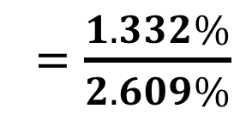
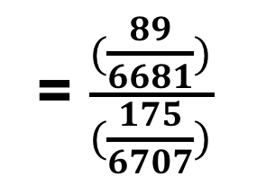
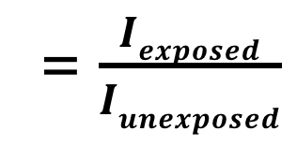
Review Problem #2:
Tamoxifen and cancer
C. Calculate and interpret epidemiologic measure of association.
Answer: RR
= $\frac{(\frac{89}{6681})}{(\frac{175}{6707})}$
RR
= $\frac{Iexposed}{Iunexposed}$
= $\frac{1.332\%}{2.609\%}$
= 0.5106
Interpretation: Women on tamoxifen have a 49% reduced risk of breast cancer versus
women on placebo (RR = 0.5106; 95% CI=
(0.3965, 0.6575). Significant protective effect exists since CI excludes one.

Slide 49
Review Problem #3:
Sample computer output
Describe the example and conclusion based on the computer output.
An independent samples t-test was performed to determine whether a difference exists in mean number of drinks in previous week for treatment versus controls. From 95% CI, we can conclude treatment group (n=244, M=13.62, SD=12.39) consumed anywhere between 0.92 to 5.56 fewer drinks than controls (n= 238, M=16.86, SD=13.49). Results are statistically significant since zero is excluded from CI.

Slide 50
Review Problem #4:
Intracellular calcium & blood pressure
Independent samples t-test; comparing mean of continuous variable (calcium concentration) between two independent groups (normal versus high blood pressure).

Slide 51
Review Problem #4: Results from OpenEpi
Must present results from “unequal variance” row.
This small p-value indicates equal variances cannot be assumed!
Statistically significant difference exists in platelet calcium concentration between participants with normal (M=107.9 nM, SD=16.1) versus high (M=168.2 nM, SD=31.7) blood pressure; t_{unequal variances} (67) = -11.168, p <0.001).

Slide 52
Review Problem #5:
HBE levels in men
One-way analysis of variance; comparing mean of continuous variable (HBE levels) for three independent groups.

Slide 53
Review Problem #5: Results from OpenEpi
ANOVA p > 0.05, so do not reject null.
Insufficient evidence to indicate differences in mean HBE concentrations (pg/ml) of men in fitness program (M=38.7, SD=16.1), joggers (M=35.7, SD=13.4), and sedentary men (M=42.5, SD=12.8); F(2,33)=0.580, p=0.565.

